Slide 1
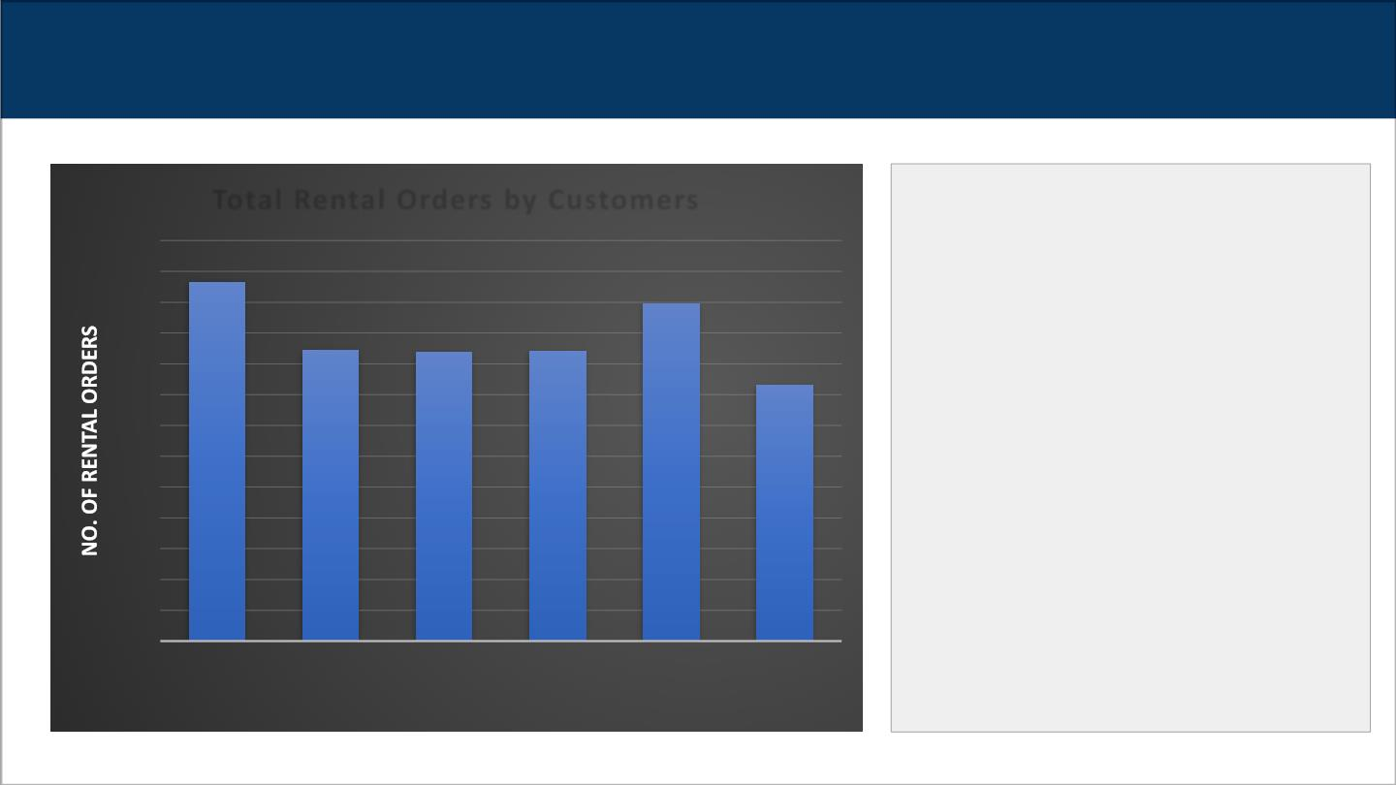
What is the trend in the number of total rental orders till now for each category of family
movies ?
Total Rental Orders by Customers
The graph is showing the rental orders for
1300
1200
1100
1000
900
800
700
600
500
400
300
200
100
0
each category of family movies till now.
1166
It is show from the data that families
are most likely to rent movies in the
‘Animation’ category followed by ‘Family’
category with almost the same interest for
‘Children’, ‘Classics’ and ‘Comedy’
1096
945
939
941
830
categories and families show least interest
to rent ‘Music’ category movies.
with the total of each categories
Animation
Children
Classics
Comedy
Family
Music
MOVIE NAME CATEGORY

Slide 2
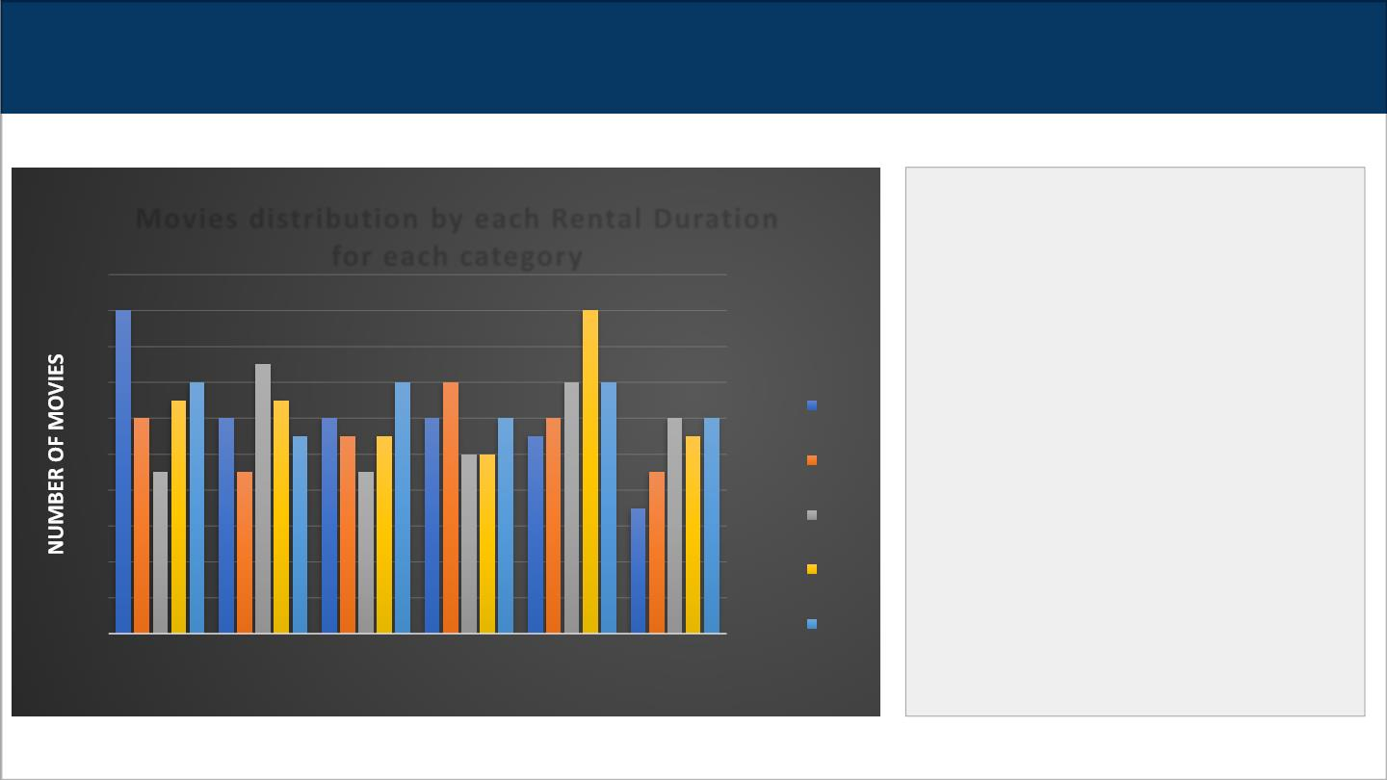
For all rental orders till now, how the length of rental duration of specifically ‘Family’
category movies compares to the duration that all family movies are rented for?
Movies distribution by each Rental Duration
The graph here shows the distribution of
movies by each rental duration for each
category of the family movies.
for each category
20
18
18
18
16
14
12
10
8
It can be clearly seen that maximum
number of movies in the ‘Family’
category are rented for 6 days in
comparison to maximum number of
movies in the ‘Animation’ category which
are being rented for certain days.
15
14
14
14
14 14
13
13
12
12
12
12
12
12
12 12
11
3
11
11 11
11
9
1010
9
9
9
4
5
6
7
7
6
4
2
0
Animation
Children
Classics
Comedy
Family
Music
MOVIE NAME CATEGORY

Slide 3
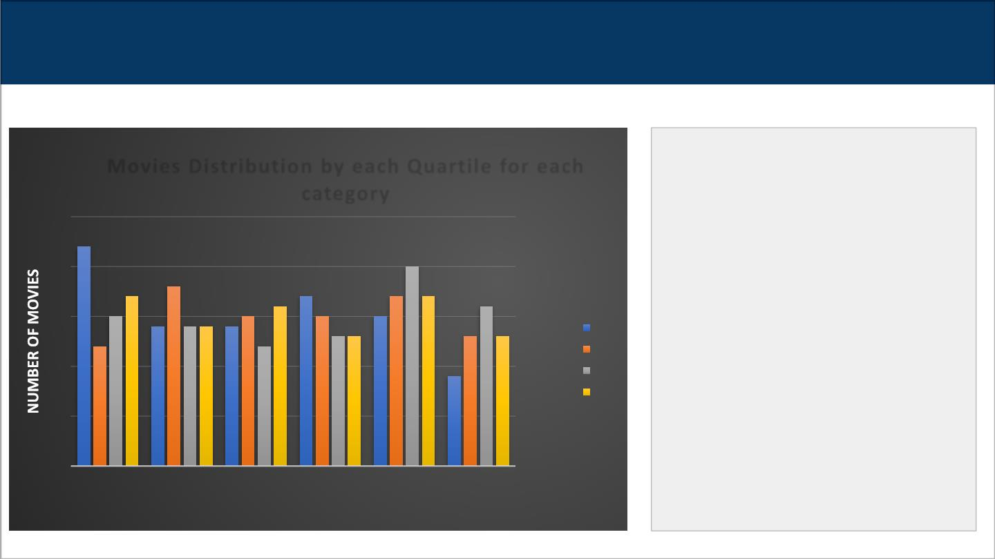
How can we compare the number of movies in each quartile for each category of family movies
if we sort all movies according to the rental duration in ascending order of duration?
The graph here shows the distribution of
movies by each quartile for each
category of family movies when within
Movies Distribution by each Quartile for each
category
25
20
15
10
5
the database all movies were sorted
according to the rental duration in
ascending order of duration.
22
20
17
18
17
17
17
15
16
16
14
14 14 4
15
15
15
Here, if we see the ‘Animation’
12
12
13 13
13
13
1
2
3
4
category, we can clearly tell that it has
the highest number of movies in the first
quartile in its own category and among
all other categories. Within the
category, there are 17 movies in the
fourth quartile on the second place
followed by number of movies in the
third and fourth quartile. Similarly, we
can do comparison for other categories.
9
0
Animation
Children
Classics
Comedy
Family
Music

Slide 4
We want to find out how the two stores compare in their count of rental orders during every month for all the years we have data for.
The count of rental orders is sorted in descending order
The graph show us the data that is provided for years in returned for data.
We want to find out how the two stores compare in their count of rental orders during every month for all the years we have data for. Where data is allocated in Months, Years ,count _rental and Store ID
3367
2794
YEARS
2006
3342
2892
2005
2004
2003
7
7
8
8
DATA IN YEARS

Slide 5
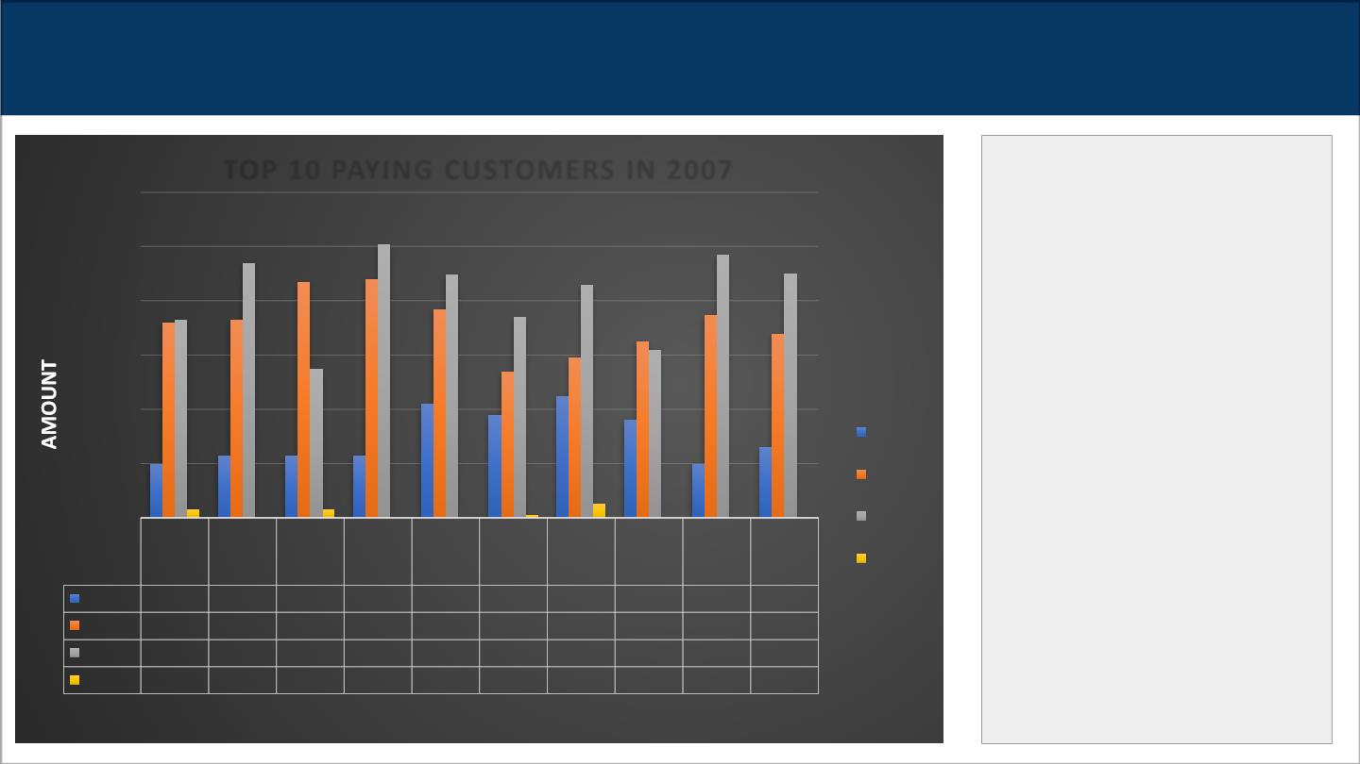
Who were the top 10 paying customers and what was the amount of the monthly payments
they made in 2007 ?
TOP 10 PAYING CUSTOMERS IN 2007
The graph is showing the top 10
paying customers in 2007 in
order of their names with the
amount of the monthly
$120.00
$100.00
$80.00
$60.00
$40.00
$20.00
$0.00
payments they made in 2007.
As we can see here, that
Eleanor Hunt has made the top
monthly payment of $100 in
April 2007.
Feb-07
Mar-07
Apr-07
May-07
Clara
Bradley Shaw
Rhonda
Kenned
y
Ana
Curtis Eleanor
Karl
Seal
Marcia Marion Mike
Dean Snyder Way
Tommy
Collazo
Irby
Hunt
Feb-07 $19.96 $22.94 $22.94 $22.95 $41.91 $37.92 $44.92 $35.94 $19.96 $25.93
Mar-07 $71.84 $72.84 $86.83 $87.82 $76.87 $53.90 $58.88 $64.85 $74.85 $67.88
Apr-07 $72.88 $93.82 $54.86 $100.78 $89.80 $73.80 $85.82 $61.88 $96.81 $89.82
May-07 $2.99
$2.99
$0.99
$4.99

Slide 6

REFERENCES
Here is the information regarding the code or query references of the visualizations and insights mentioned in the above slides:
1. Slide 1 : Query1 – Simanga Mchunu Investigate Relational Database.txt
2. Slide 2 : Query2 – Simanga Mchunu Investigate Relational Database.txt
3. Slide 3 : Query3 – Simanga Mchunu Investigate Relational Database.txt
Slide 4 : Query4 – Simanga Mchunu Investigate Relational Database.txt
Slide 5 : Query5– Simanga Mchunu Investigate Relational Database.txt

